Slide 1

Interaction
How to talk to robots

Slide 2
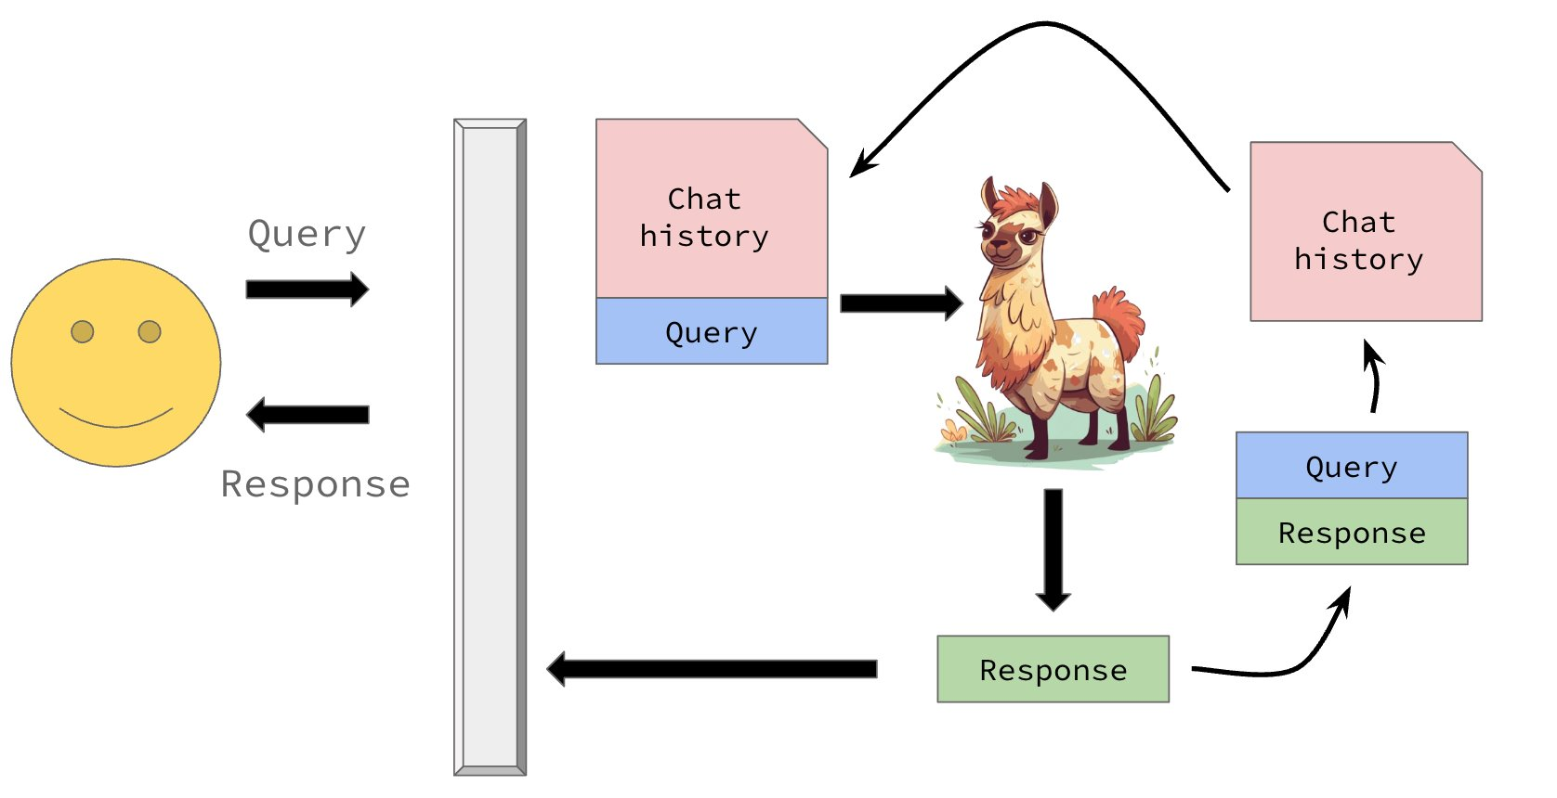
Before we begin
Notes:
This is you.

Slide 3
How do we, as mere humans, who can only type in plain text, interact with these models?

Slide 4
The OpenAI API
What is an API?
It is a way of defining how you interact with a piece of software
What is the OpenAPI?
It is just a specific type of API!
Think about what happens when you order food at a restaurant...

Slide 5
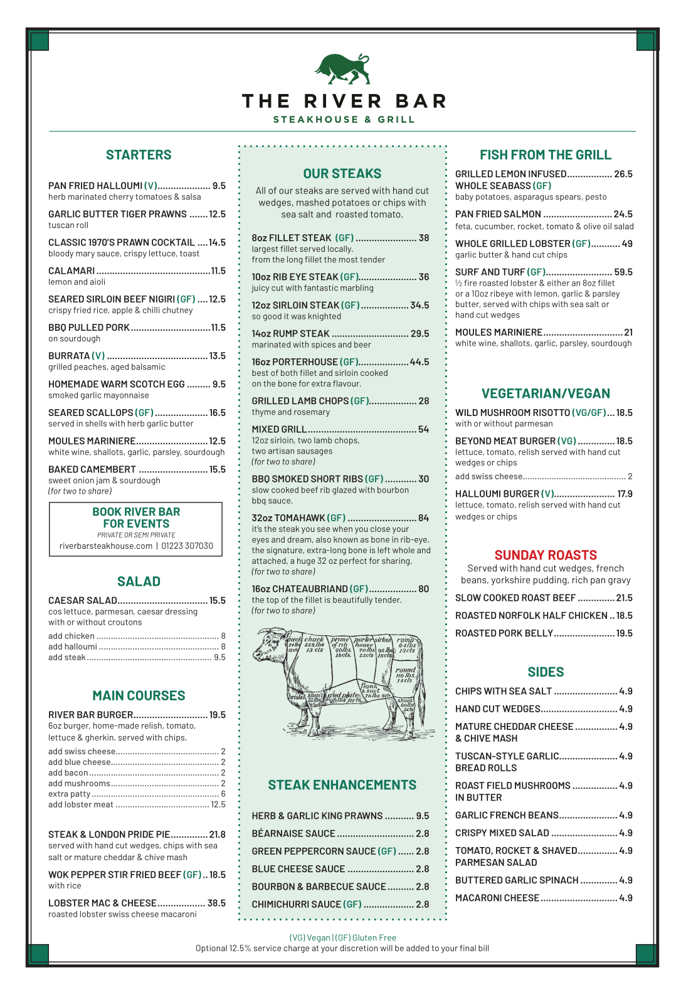
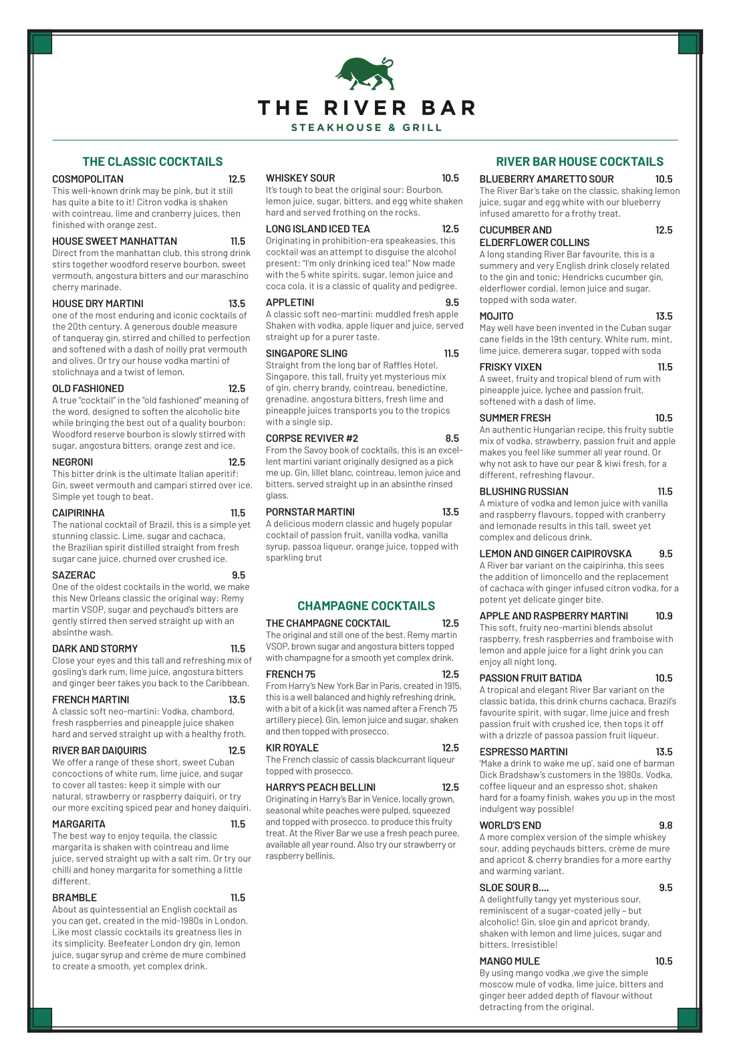

Slide 6
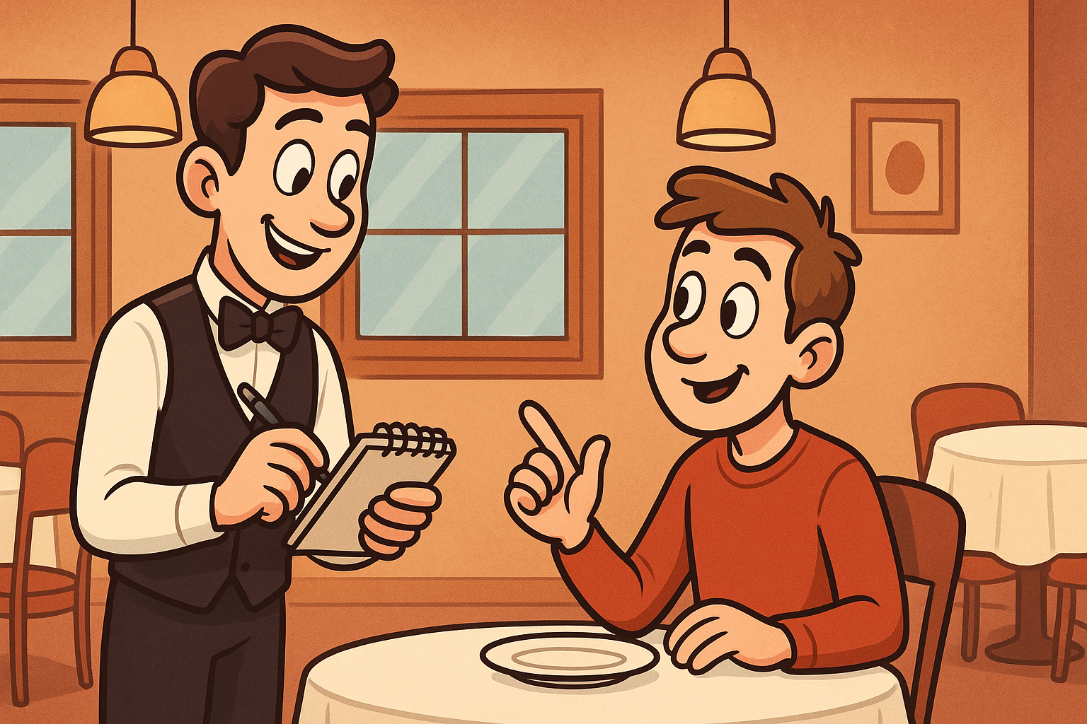
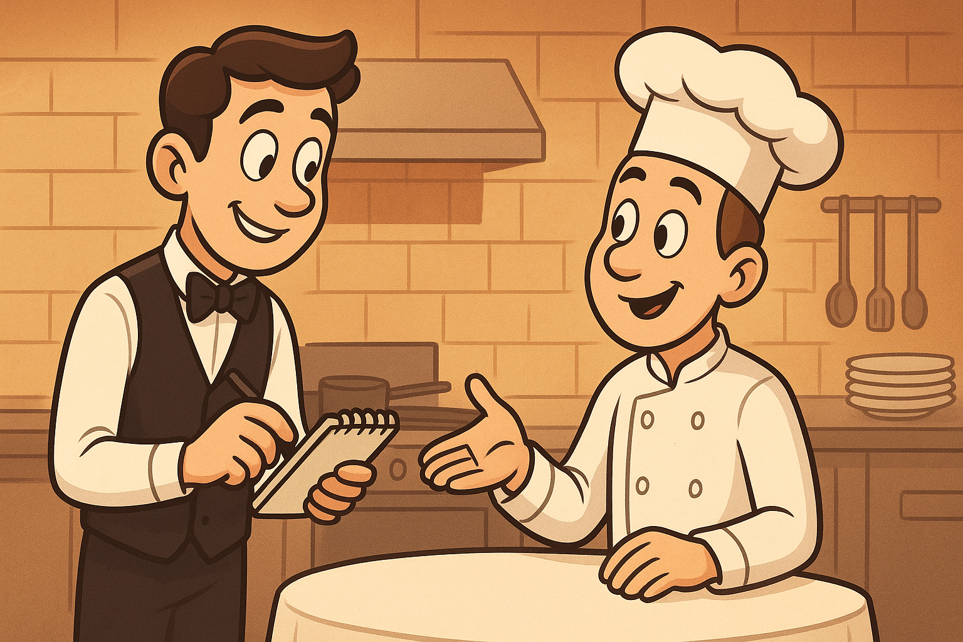

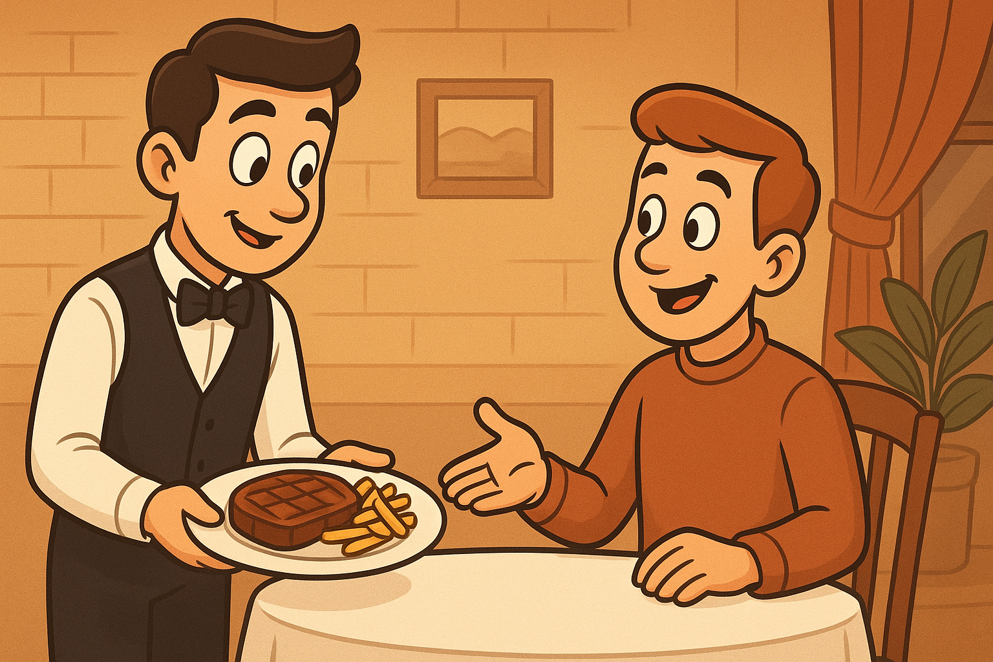

Slide 7

chat template
<|begin_of_text|><|start_header_id|>system<|end_header_id|> You are a helpful assistant.<|eot_id|><|start_header_id|>user<|end_header_id|> Give me a recipe for apple pie.<|eot_id|><|start_header_id|>assistant<|end_header_id|>
"Give me a recipe for apple pie."
Generate until we see special end token
tokenizer
[101,
102, 5921, 103,
84011, 97432, 34587, 123, 712, 104,
102, 1246, 103,
1487, 34578, 8891, 67, 86, 12413, 1775, 104,
102, 1346, 103]

Slide 8

The OpenAI API
The OpenAI API makes it very convenient to "communicate" with LLMs
You can basically wrap any generative LLM in the OpenAI API...

Slide 9
Session state
LLMs, as a fundamental unit, are stateless...
...so a software engineer has to "manage" a conversation

Slide 10
Session state
Notes:
This is you.

Slide 11
How do we manage session state?
LLMs have distinct input and output patterns...
‘system’ : “You are an expert in baking.”
‘user’ : “Provide me a recipe for macarons.”
‘assistant’ : “Certainly! Here is a recipe for macarons …”
Almost all LLMs follow this pattern...
...break this pattern, and you'll soon see the model produce nonsense.

Slide 12
How do we manage session state?
‘system’ : “You are an expert in baking.”
‘user’ : “Provide me a recipe for macarons.”
‘assistant’ : “Certainly! Here is a recipe for macarons …”
‘user’ : “Is this the only way to make them?”
‘assistant’ : “Actually no! There are two common ways to …”
‘user’ : “I think I'll try the Italian method first.”
‘assistant’ : “What an insightful idea! Let's get started …”

Slide 13
How do we manage session state?
session_state = [
‘system’ : “You are an expert in baking.”,
‘user’ : “Provide me a recipe for macarons.”,
‘assistant’ : “Certainly! Here is a recipe for macarons …”,
‘user’ : “Is this the only way to make them?”,
‘assistant’ : “Actually no! There are two common ways to …”,
‘user’ : “I think I'll try the Italian method first.”,
‘assistant’ : “What an insightful idea! Let's get started …”,
…
]

Slide 14


Slide 15
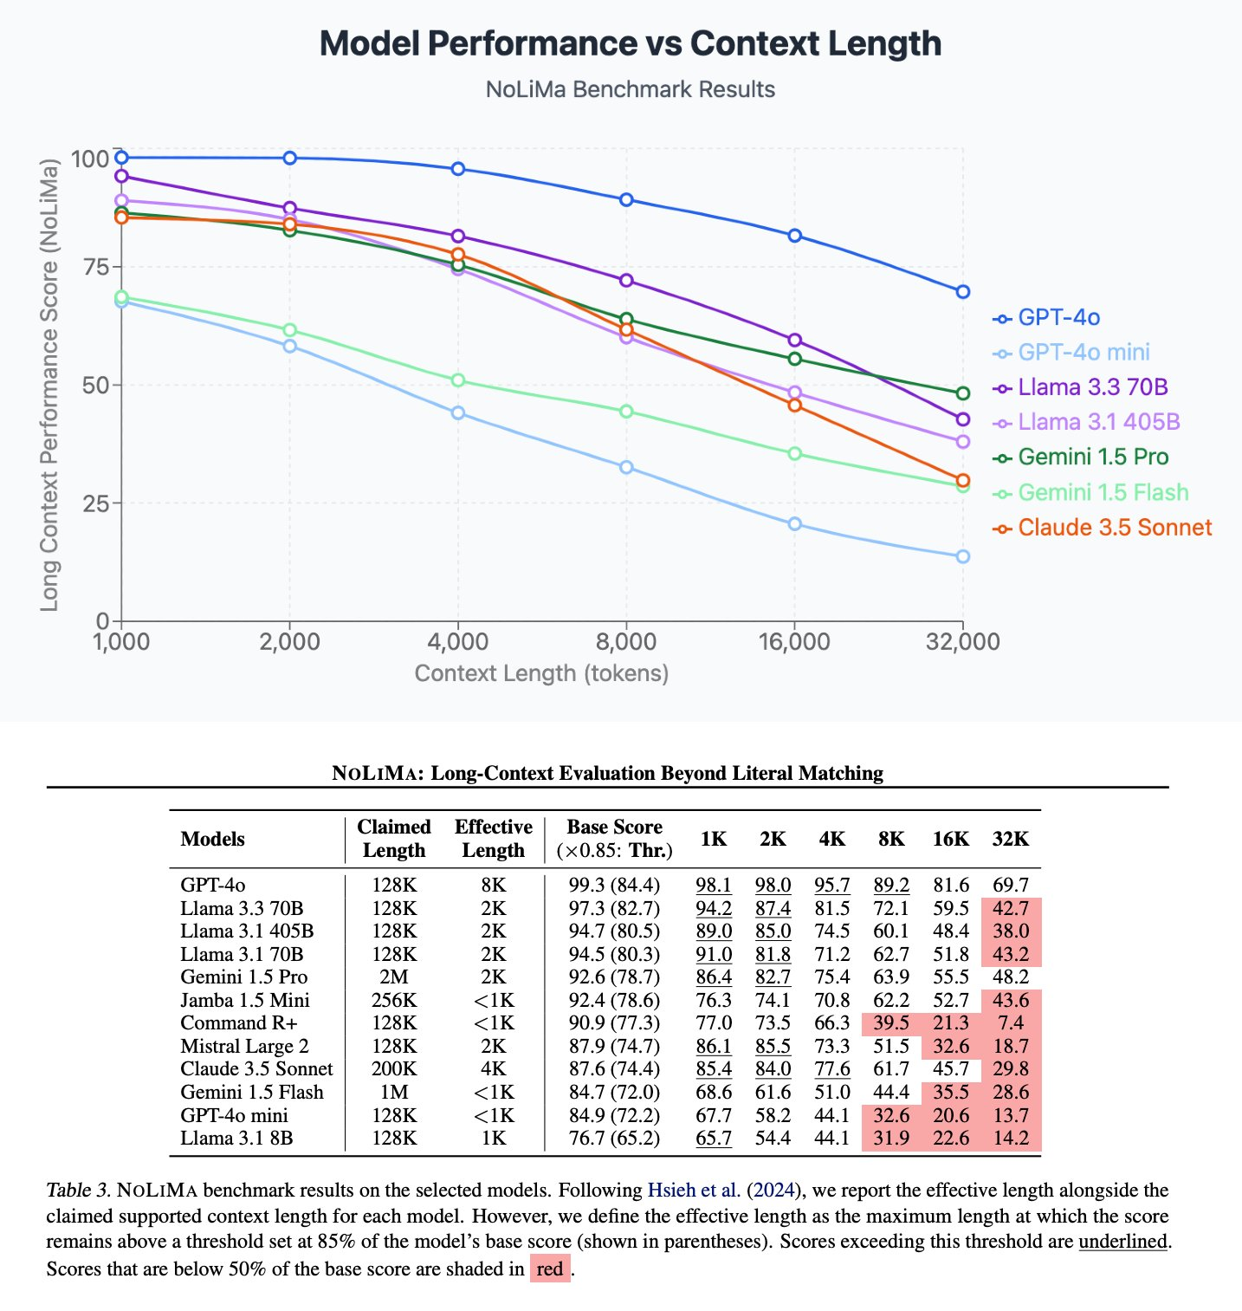
https://arxiv.org/abs/2502.05167

